Slide 1

Directed Flow in Au+Au Collisions
Markus D. Oldenburg
Lawrence Berkeley National Laboratory
Theory Seminar
Johann Wolfgang Goethe-Universität, Frankfurt, January 2005

Slide 2
Overview
Introduction
Model Predictions for Directed Flow
Measurements & Results
Model comparisons to data
Summary and Outlook

Slide 3
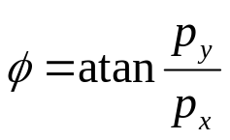

Anisotropic Flow
y
x
z
spatial
anisotropy
momentum
anisotropy
sensitive to the EoS
x
z
peripheral collisions produce an asymmetric particle source in coordinate space
Fourier transformation of azimuthal particle distribution in momentum space yields coefficients of different order
    v₁: “directed flow”
    v₂: “elliptic flow”

Slide 4

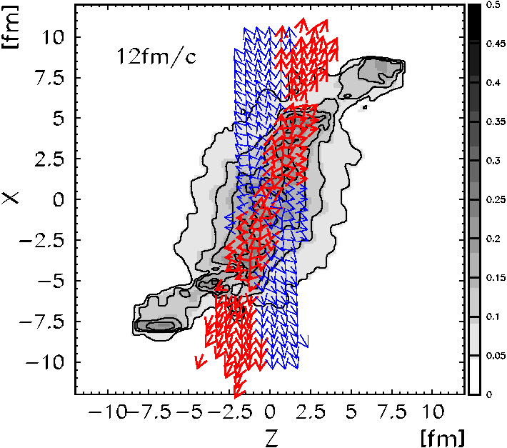
Antiflow of nucleons
Au+Au, E^{kin}_{Lab}= 8 A GeV
“Bounce off”: nucleons at forward rapidity show positive flow.
If matter is close to softest point of EoS, at mid-rapidity the ellipsoid expands orthogonal to the longitudinal flow direction.
Softening of the EoS can occur due to a phase transition to the QGP or due to resonances and string like excitations.
At mid-rapidity, antiflow cancels “bounce off”.
Baryon density
flow
antiflow
QGP ⇒ v₁(y) flat at mid-rapidity.
J. Brachmann, S. Soff, A. Dumitru, H. Stöcker, J. A. Maruhn, W. Greiner, L. V. Bravina, D. H. Rischke, PRC 61 (2000), 024909.

Slide 5
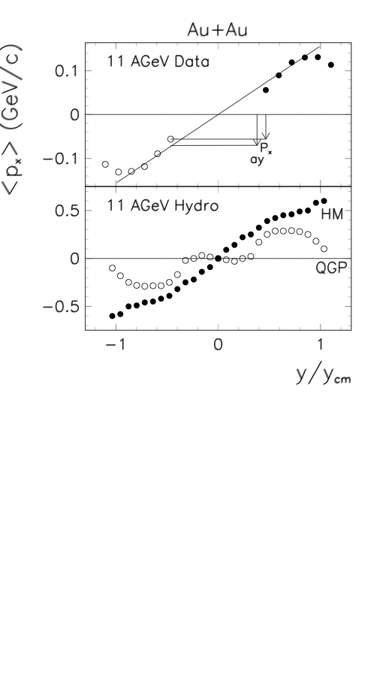
3rd flow component
At lower energies straight line behavior of v₁(y) was observed.
QGP forms rather flat disk at mid-rapidity
expansion takes place in the direction of largest pressure gradient. i.e. in the beam direction
In peripheral collisions the disk is tilted and directed flow opposite to the “standard” direction develops.
Models with purely hadronic EoS don’t show this effect.
protons
QGP ⇒ v₁(y) flat at mid-rapidity.
L. P. Csernai, D. Röhrich, PLB 45 (1999), 454.

Slide 6
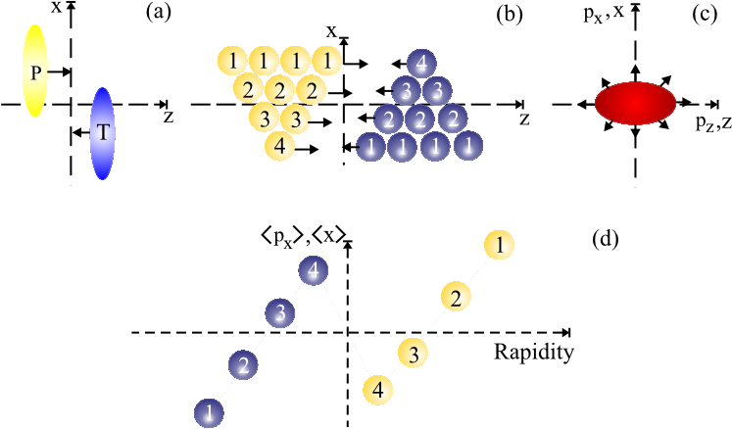
Stopping and space-momentum correlation
collective expansion of the system implies positive space-momentum correlation
wiggle structure of v₁(y) develops
shape of wiggle depends on:
  centrality
  system size
  collision energy
R. Snellings, H. Sorge, S. Voloshin, F. Wang, N. Xu, PRL 84 (2000), 2803.

Slide 7
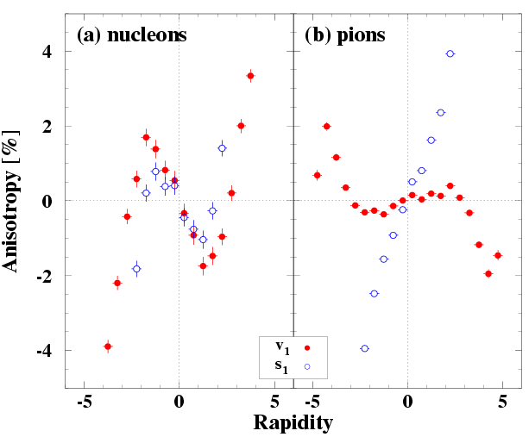
Stopping and space-momentum correlation II
RQMD v2.4 (cascade mode)
nucleons show strong positive space-momentum correlation
pions show a positive space-rapidity correlation (without a wiggle)
positive space-momentum correlation makes pion v₁(y) follow s₁(y) and mid-rapidity
at forward rapidities shadowing is the main source of pion v₁
depending on the strength of these two effects, even pion v₁(y) shows a wiggle structure or flatness at mid-rapidity
√s = 200 GeV
No QGP necessary ⇒ v₁(y) “wiggle”.
R. Snellings, H. Sorge, S. Voloshin, F. Wang, N. Xu, PRL 84 (2000), 2803.

Slide 8
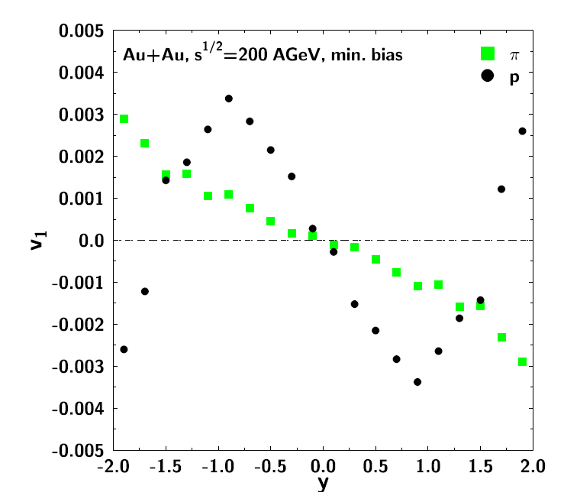
Stopping and shadowing in UrQMD
UrQMD 1.2
space-momentum correlation can be addressed by rapidity dependence of v₁
(weak) negative slope of v₁(y) for protons at mid-rapidity
at forward rapidities proton v₁ shows “bounce off” effect
pions show an overall negative slope of v₁(y) (shadowing at forward rapidities)
No QGP necessary ⇒ proton v₁(y) “wiggle”.
M. Bleicher and H. Stöcker, PLB 526 (2002), 309.

Slide 9
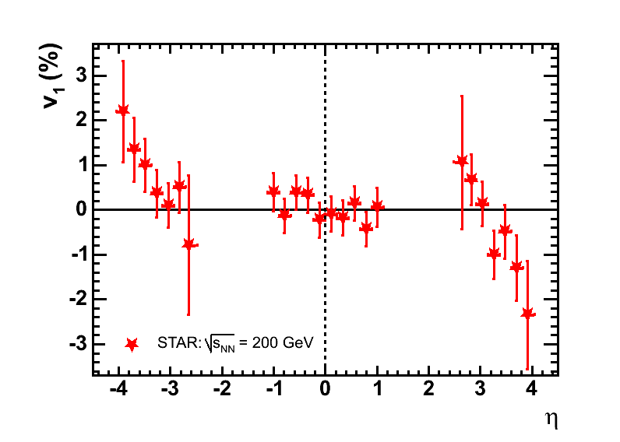
Directed flow (v₁) at RHIC at 200 GeV
charged particles
shows no sign of a “wiggle” or opposite slope at mid-rapidity
Predicted magnitude of a “wiggle” couldn’t be excluded.
v₁ signal at mid-rapidity is rather flat
J. Adams et al. (STAR collaboration), PRL 92 (2004), 062301.

Slide 10
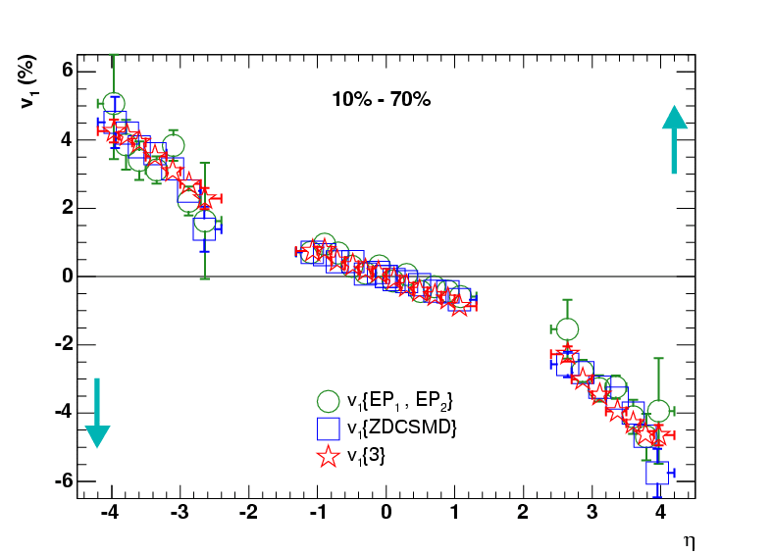
Charged particle v₁(η) at 62.4 GeV
STAR preliminary
Three different methods:
  v₁{3}
  v₁{EP₁,EP₂}
  v₁{ZDCSMD}
Sign of v₁ is determined with spectator neutrons.
v₁ at mid-rapidity is not flat, nor does it show a “wiggle” structure
charged particles

Slide 11
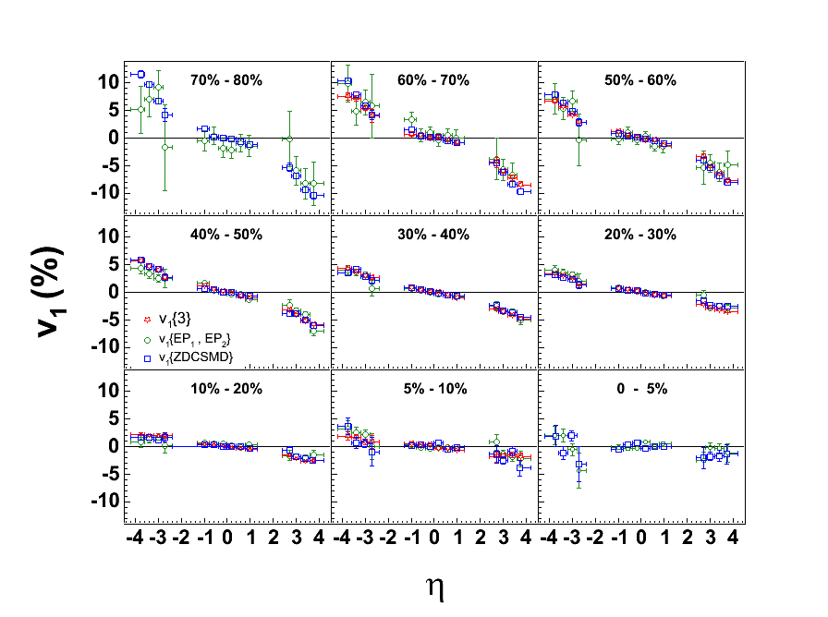

Centrality dependence of v₁(η) at 62.4 GeV
STAR preliminary
Different centrality bins show similar behavior.
Methods agree very well.
Most peripheral bin shows largest flow.
charged particles

Slide 12
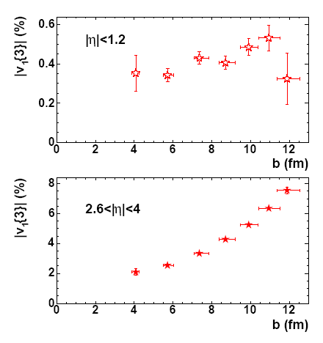
Centrality dependence of integrated v₁
midrapidity
integrated magnitude of v₁ increases with impact parameter b
The strong increase at forward rapidities (factor 3-4 going from central to peripheral collisions) is not seen at mid-rapidities.
Note the different scale for mid-rapidity and forward rapidity results!
charged particles
STAR preliminary
forward rapidity

Slide 13
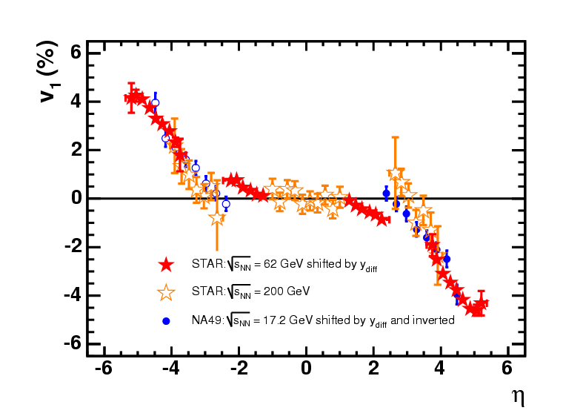
Comparison of different beam energies
STAR preliminary
Data shifted with respect to beam rapidity.
good agreement at forward rapidities, which supports limiting fragmentation in this region
charged particles
y_{diff} = y_{200GeV} – y_{17.2,62.4GeV}
y_{200GeV} = 5.37
y_{62.4GeV} = 4.20
y_{17.2GeV} = 2.92
NA49 data taken from:
C. Alt et al. (NA49 Collaboration), Phys. Rev. C 68 (2003), 034903.

Slide 14
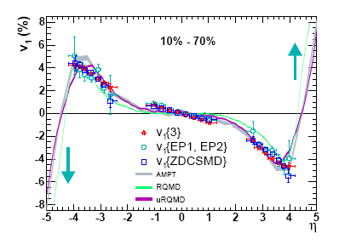
v₁ data and simulations at 62.4 GeV
STAR preliminary
All models reproduce the general features of v₁ very well!
At high η: Geometry the only driving force?
[see Liu, Panitkin, Xu: PRC 59 (1999), 348]
At mid-rapidity we see more signal than expected.
charged particles

Slide 15
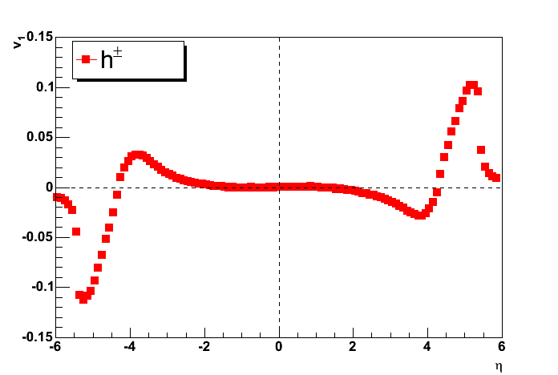
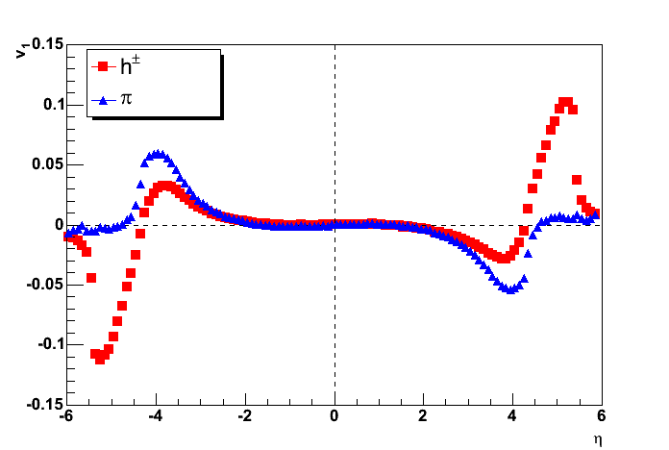
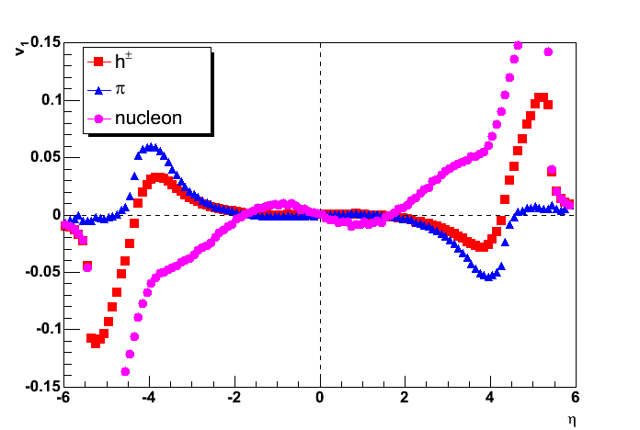
RQMD simulations for 62.4 GeV I
Hadron v₁ is very flat at mid-rapidity.
Pion v₁ is very flat at mid-rapidity, too.
(There is a very small positive slope around η=0.)
Proton v₁ shows a clear “wiggle” structure at mid-rapidity.
The overall (= hadron) behavior of v₁ gets more and more dominated by protons when going forward in pseudorapidity.

Slide 16
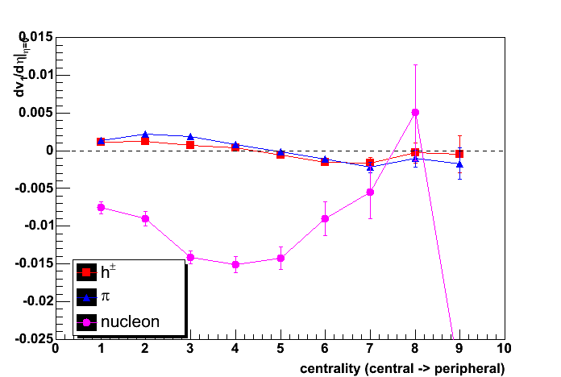
RQMD simulations for 62.4 GeV II
- slope of v₁ at midrapidity -
The overall (= hadron) slope of v1 at mid-rapidity is very small.
It is dominated by pions.
Protons show a much larger and negative slope at mid-rapidity.

Slide 17
Summary I
Directed flow v₁ of charged particles at 62.4 GeV was measured.
The mid-rapidity region does not show a flat signal of v₁. A finite slope is detected.
The centrality dependence of v₁(η) shows a smooth decrease in the signal going from peripheral to central collisions.
At mid-rapidity there’s no significant centrality dependence of v₁ observed, while at forward rapidities directed flow increases 3-fold going from central to peripheral collisions.
At forward rapidities our signal at 62.4 GeV agrees with (shifted) measurements at 17.2 and 200 GeV.

Slide 18
Summary II
Model predictions for pseudorapidity dependence of v₁ agree very well with our data, especially at forward rapidities.
The very good agreement between different models indicates a purely geometric origin of the v₁ signal.
RQMD simulations show a sizeable wiggle in protons v₁(η), only.
Measurements of identified particle v₁ at mid-rapidity will further constrain model predictions.
High statistics measurement of v₁ at 200 GeV to come.

Slide 19
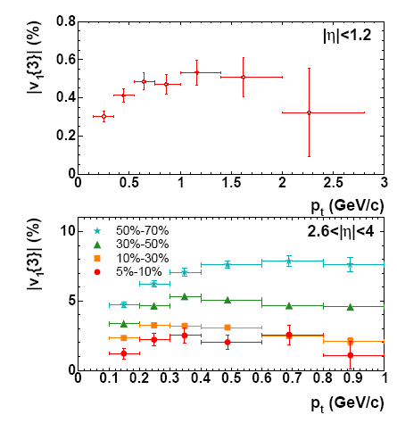
Directed flow v₁ vs. transverse momentum p_{t}
STAR preliminary
midrapidity
magnitude of v₁ increases with p_{t} and then saturates
Note the different scale for mid-rapidity and forward rapidity results!
both plots for centrality 10-70%
forward rapidity
p_{t}-dependence of v₁ still awaits explanation by models!

Slide 20
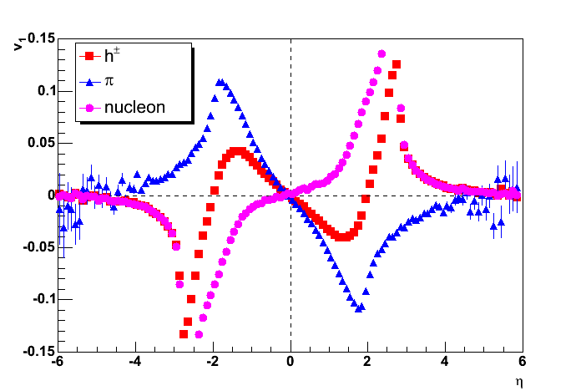
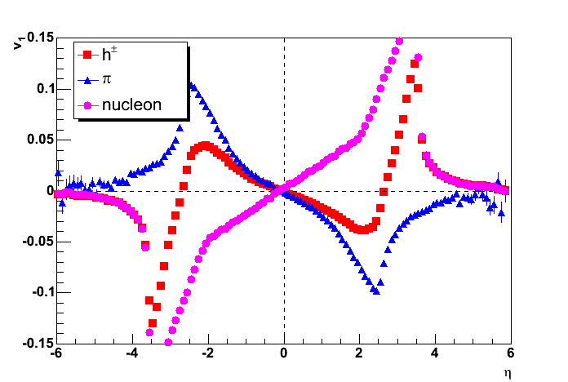
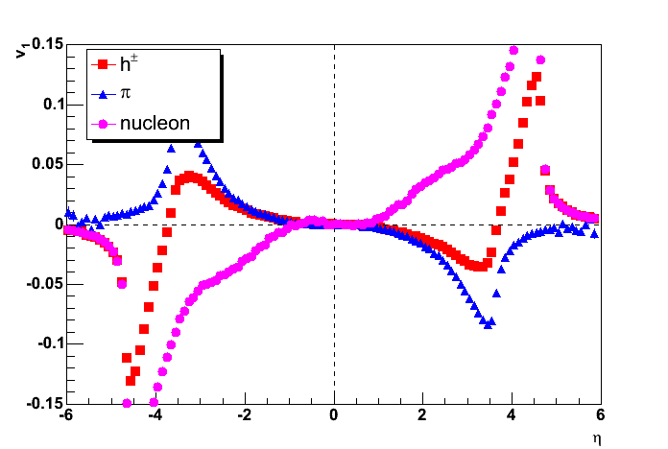
RQMD energy scan
√s_{NN} = 5 GeV
√s_{NN} = 10 GeV
√s_{NN} = 30 GeV
√s_{NN} =62.4 GeV

Slide 21
Backup

Slide 22
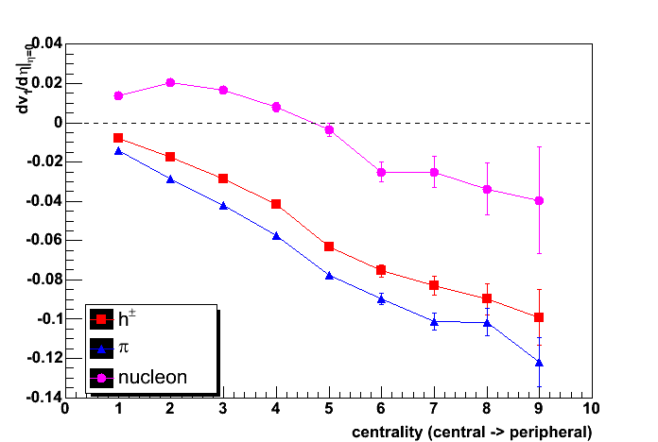
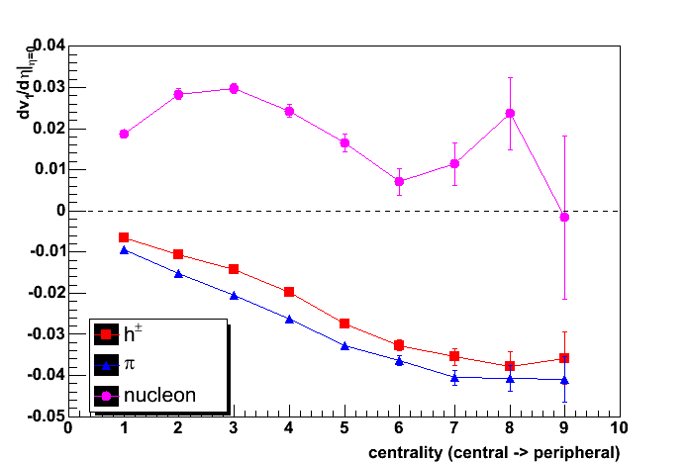
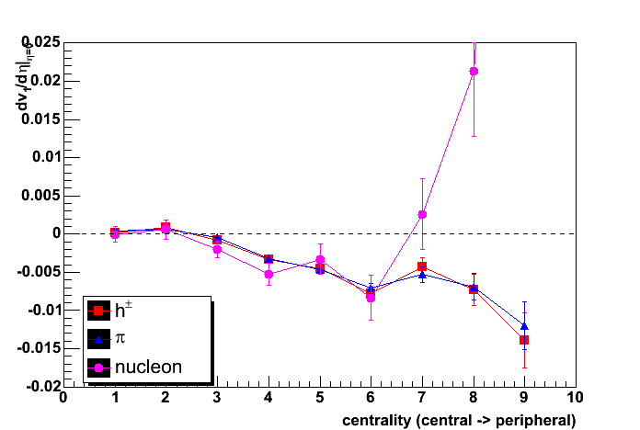
RQMD energy scan II
√s = 5 GeV
√s = 10 GeV
√s = 30 GeV
√s = 62.4 GeV

